Slide 1
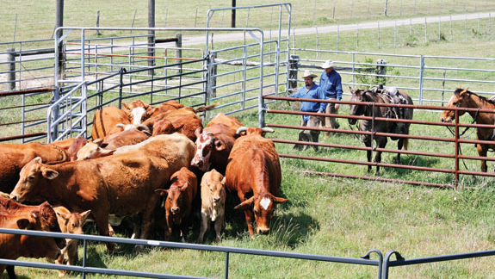
The Basics of Cattle Handling & Facilities
Presented by AABP

Slide 2
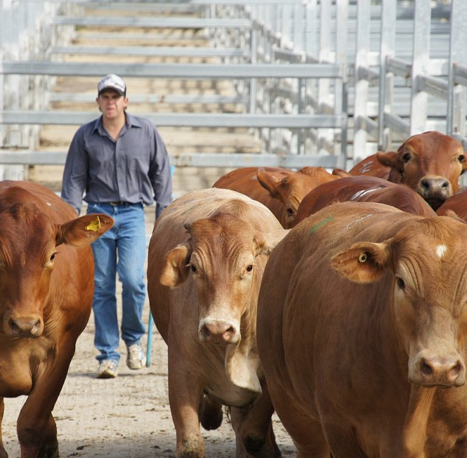
Hearing
Loud or high-frequency noises are stressful to cattle.
They can differentiate threatening noises directed at them vs. background noise (ex. from equipment running)
Cattle make positive and negative associations with noises (ex. positive = feed truck)

Slide 3
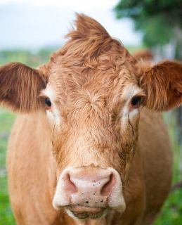
Sight
Cattle can see nearly 360 degrees without their heads.
They are very sensitive to contrasts in lighting – moving toward light & away from shadows
They are very aware of sudden movements & like to observe their surroundings before moving through a facility

Slide 4
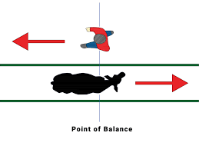
Flight Zone
A cow’s flight zone is at their shoulder.
If you need them to move forward, you position yourself in behind the shoulder.
If you need them to move backward, you position yourself in front of the shoulder.

Slide 5
How do these behaviors effect handling?
Notes:
Let’s watch this short video by Dr. Temple Grandin on how cattle behavior plays such a big part in handling!

Slide 6
What do you see here?
Notes:
What do you see here that might deter a cow from entering the alleyway?
Contrast in lighting
Slatted “walls” allowing for cattle to see people

Slide 7
What about here?
Notes:
Great alleyway! Cows won’t be able to see any handlers through the walls
One thing that might be a disadvantage is the movement from sunshine to darkness in the barn if they had a chute set up in there. Maybe could add some skylights in the barn to help decrease contrast as mentioned in Dr. Grandin’s video

Slide 8
Last one! What do you see here?
Notes:
The jacket on the gate – may cause these calves to hesitate

Slide 9
How can we prevent stress during handling? (using what we’ve learned about behavior)
Avoid
Avoid sharp contrasts in lighting in our facilities
Maintain
Maintain quiet and calm voices when moving/working cattle
Check
Check for objects along fence lines or the periphery that may make cattle apprehensive (ex. hats, trucks, chains, etc.)
Design
Design alleyways which cattle can’t see through
Time
Give cattle time to observe their surroundings before “pushing” them
Use their flight zone to your advantage!
Use

Slide 10
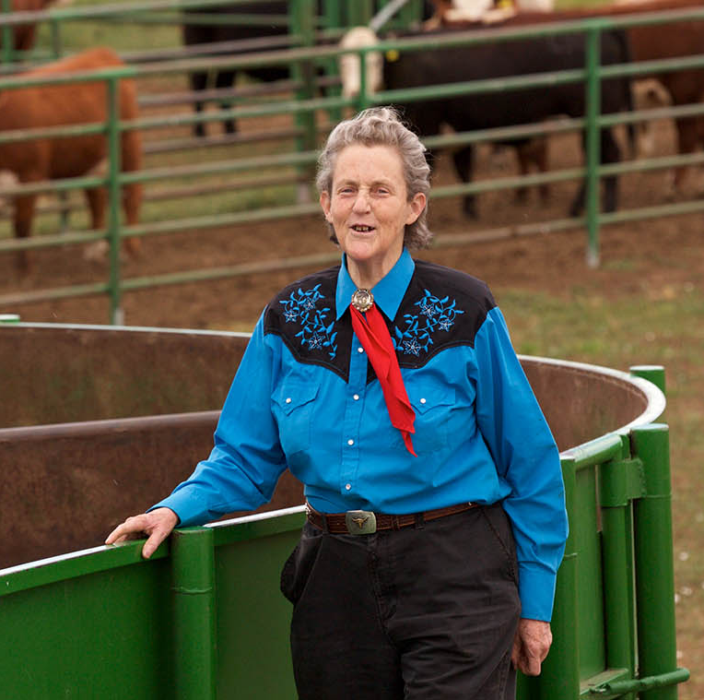
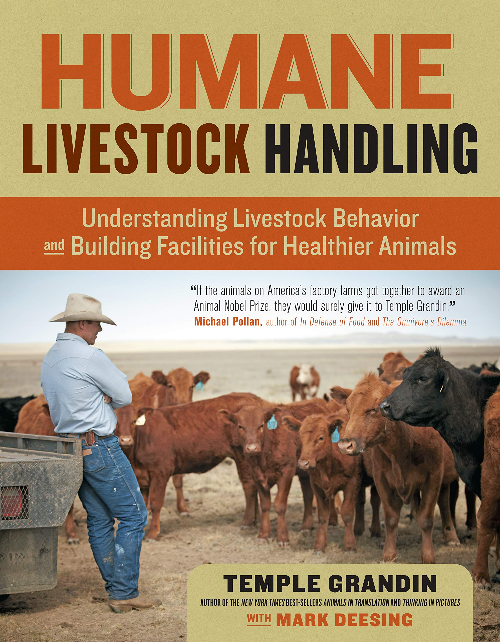
That’s all Folks!
For more information about handling, please read the provided pamphlet.
Notes:
If you’d like to learn more about Dr. Temple Grandin who has revolutionized the cattle industry with her expertise! She has lots of videos on youtube, her own website, and multiple books about animal behavior and autism! Such as Humane Livestock Handling (click) where a lot of this information came from today and Animals in Translation (click). Thank you all for your attention and I hope you found this interesting!

